Slide 1
Interacting with DestinE Data Portfolio
DestinE User Exchange #3
16th October 2024

Slide 2
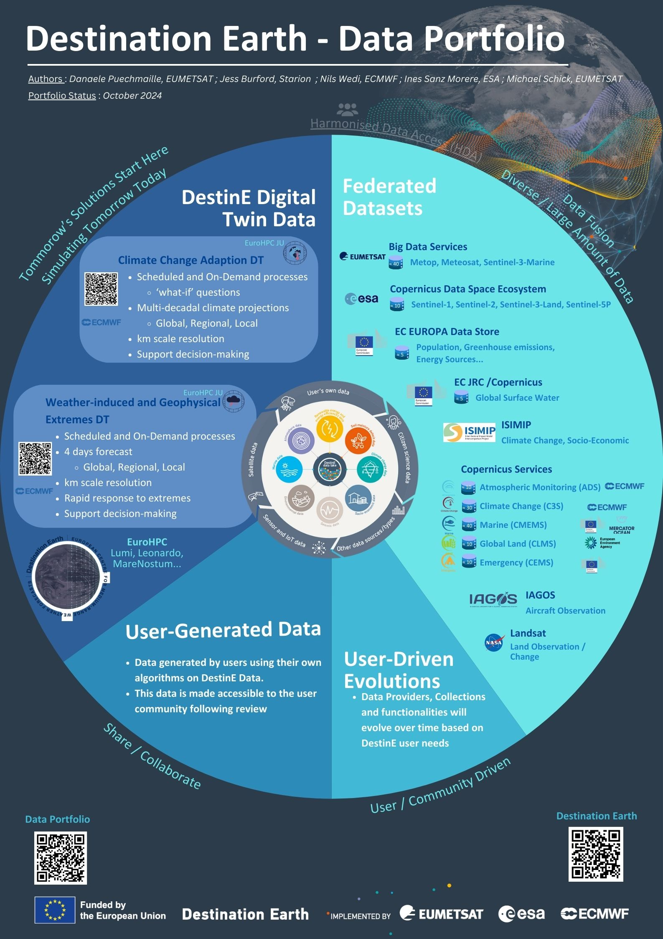
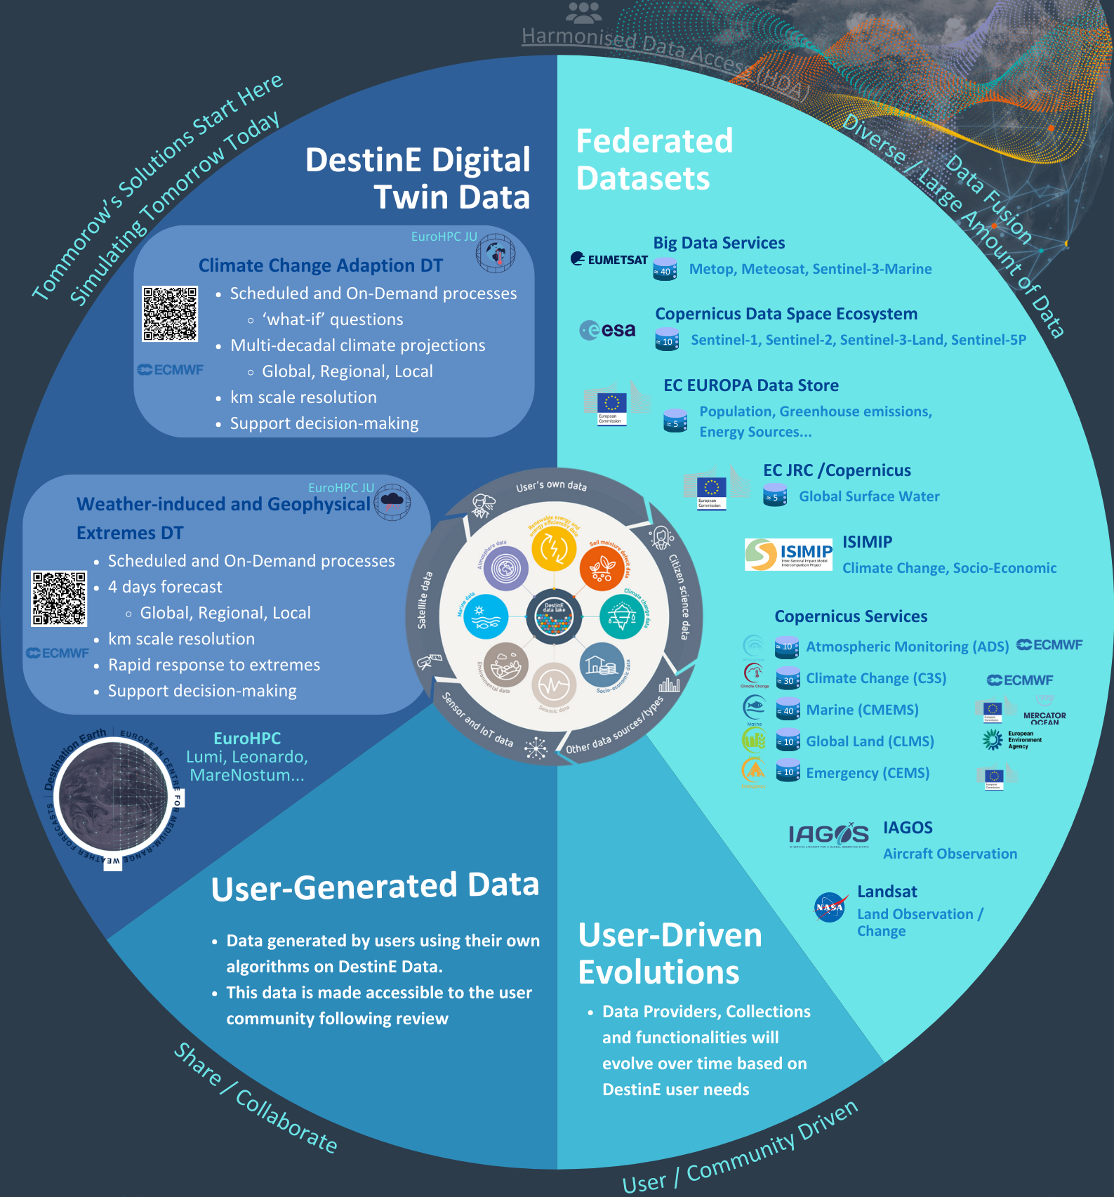
Interacting DestinE Data Portfolio
Danaële Puechmaille, EUMETSAT

Slide 4
Agenda
EDEN service in the platform
Simone Mantovani (MEEO)
Harmonised Data Access service a unified API for DestinE Data Portfolio
Aubin Lambaré (CS Sopra Steria)
SesamEO service
Frédéric Le Fur & Patrick Pradier (Gael Systems)
The Earth Data Hub
Nicola Masotti (B-Open)
DestinE Streamer
Wolfgang Kapferer (Geoville)

Slide 5
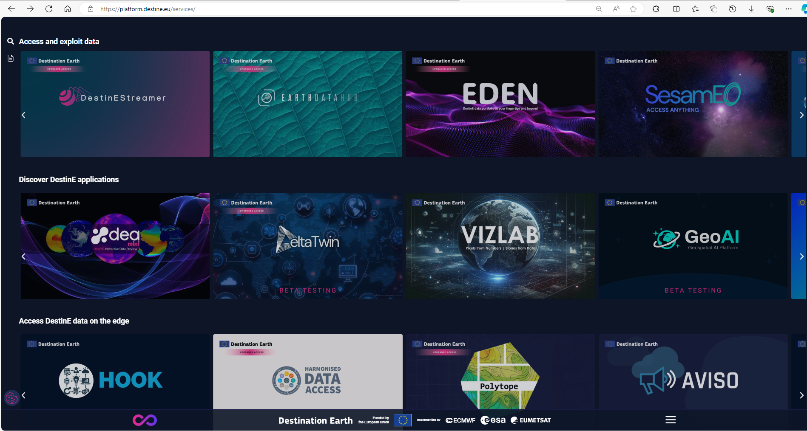
DestinE Platform, access to services
platform.destine.eu/services/

